Slide 1
GUI Testing

Slide 2
What is GUI?
There are two types of interfaces for a computer application.
Command Line Interface is where you type text and computer responds to that command.
GUI stands for Graphical User Interface where you interact with the computer using images rather than text.

Slide 3
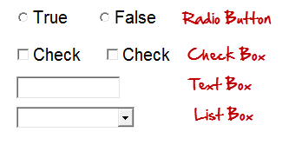
GUI Testing, is validation below elements
Following are the GUI elements which can be used for interaction between the user and application:

Slide 4
GUI Testing
GUI testing is the process of testing the system's Graphical User Interface of the Application Under Test. GUI testing involves checking the screens with the controls like menus, buttons, icons, and all types of bars - toolbar, menu bar, dialog boxes and windows, etc

Slide 5


Slide 6
What should be checked?
Apart from control checking and text.
we have to do GUI testing we first check that the images should be completely visible in different browsers.
Also, the links are available, and the button should work when clicked.

Slide 7
GUI testing checklist
Testing the size, position, width, height of the elements.
Testing of the error messages that are getting displayed.
Testing the different sections of the screen.
Testing of the font whether it is readable or not.
Testing of the screen in different resolutions with the help of zooming in and zooming out like 640 x 480, 600x800, etc.
Testing the alignment of the texts and other elements like icons, buttons, etc. are in proper place or not.
Testing the colors of the fonts.
Testing the colors of the error messages, warning messages.

Slide 8
GUI testing checklist
Testing whether the image has good clarity or not.
Testing the alignment of the images.
Testing of the spelling.
The user must not get frustrated while using the system interface.
Testing whether the interface is attractive or not.
Testing of the scrollbars according to the size of the page if any.
Testing of the disabled fields if any.
Testing of the size of the images.
Testing of the headings whether it is properly aligned or not.
Testing of the color of the hyperlink.

Slide 9
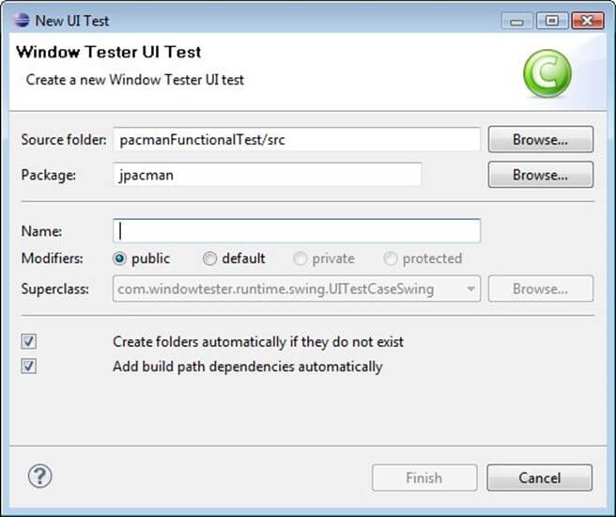

Slide 10
Solution
TC 01- Verify that the text box with the label "Source Folder" is aligned properly.
TC 02 - Verify that the text box with the label "Package" is aligned properly.
TC 03 – Verify that label with the name "Browse" is a button which is located at the end of TextBox with the name "Source Folder."
TC 04 – Verify that label with the name "Browse" is a button which is located at the end of Text Box with the name "Package."
TC 05 – Verify that the text box with the label "Name" is aligned properly.
TC 06 – Verify that the label "Modifiers" consists of 4 radio buttons with the name public, default, private, protected.
TC 07 – Verify that the label "Modifiers" consists of 4 radio buttons which are aligned properly in a row.

Slide 11
Solution(cont.)
TC 08 – Verify that the label "Superclass" under the label "Modifiers" consists of a dropdown which must be proper aligned.
TC 09 – Verify that the label "Superclass" consists of a button with the label "Browse" on it which must be properly aligned.
TC 10 – Verify that clicking on any radio button the default mouse pointer must be changed to hand mouse pointer.
TC 11 – Verify that user must not be able to type in the dropdown of "Superclass."
TC 12 – Verify that there must be a proper error generated if something has been mistakenly chosen.

Slide 12
Solution(cont.)
TC 13 - Verify that the error must be generated in the RED color wherever it is necessary.
TC 14 – Verify that proper labels must be used in the error messages.
TC 15 – Verify that the single radio buttons must be selected by default every time.
TC 16 – Verify that the TAB button must be work properly while jumping on other field next to previous.
TC 17 – Verify that all the pages must contain the proper title.
TC 18 – Verify that the page text must be proper aligned.
TC 19 – Verify that after updating any field a proper confirmation message must be displayed.
TC 20 - Verify that only 1 radio button must be selected and more than single checkboxes may be selected.

Slide 13
Challenges in GUI Testing
The most common problem comes while doing Regression Testing is that the application GUI changes frequently. It is very difficult to test and identify whether it is an issue or enhancement. The problem manifests when you don't have any documents regarding GUI changes.

Slide 14
GUI testing tools
Selenium
QTP
Cucumber
SilkTest
TestComplete
Watir

